Slide 1
Fueling your performance

Slide 2
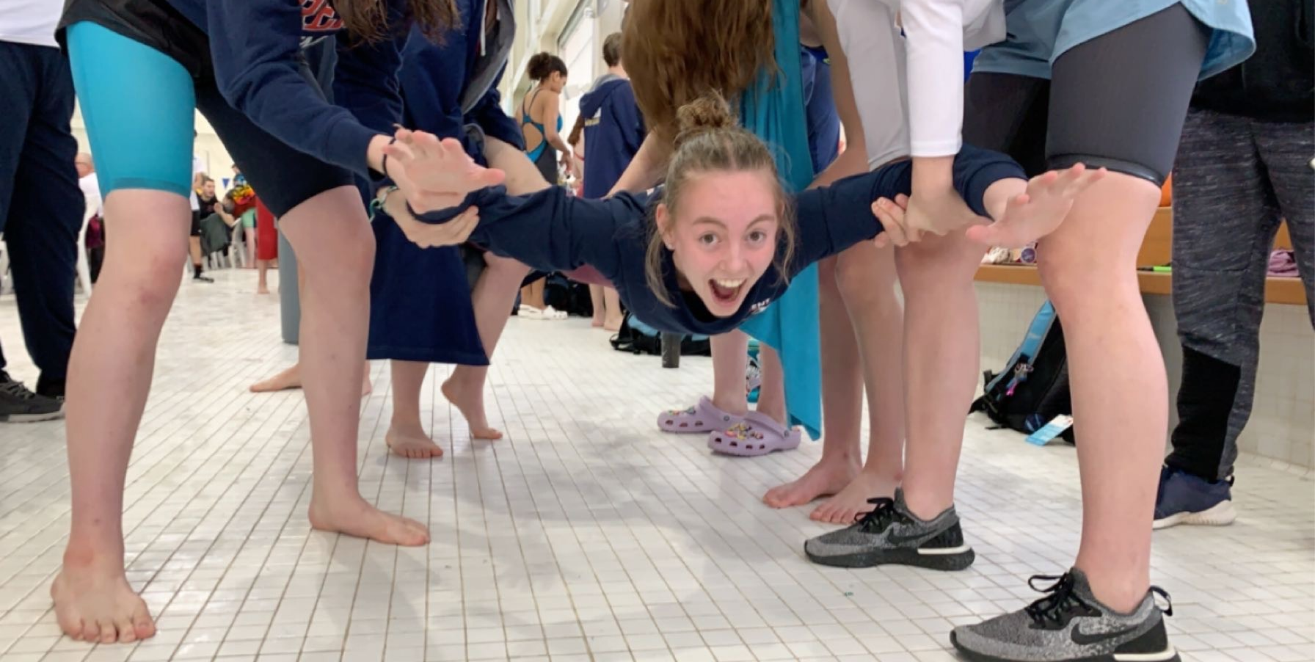
Fueling your performance
Quick and simple tips to enhance your performance

Slide 3
Fueling your performance
Proper Nutrition during multiple training days and meets provides:
Sustained energy from foods and fluids high in carbohydrate, adequate in protein, and lower in fat and fibre.
Adequate energy and nutrients to recover and prepare for the next training session or meet.
Provide adequate hydration and electrolyte balance.
Mental focus for best technique and skill execution in the pool.

Slide 4
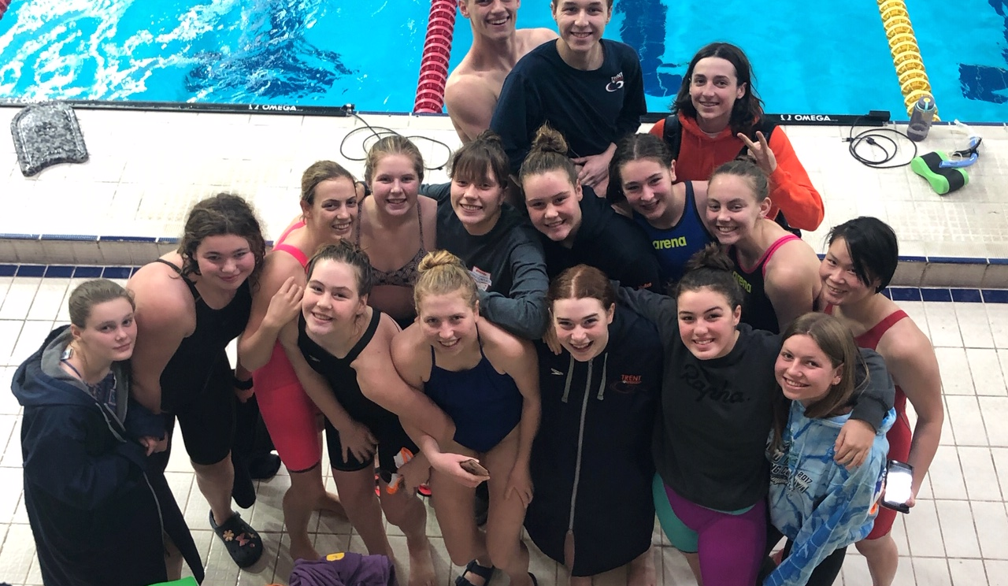
Nutrition Presentation – April 2014 Train to compete – Swim Ontario
Nutrition can be manipulated to enhance performance.
Athletes have an enhanced metabolism, compared to the general population (expending 500-1500 kcal every practice).
General population should avoid excessive carbohydrates (CHO) consumption.
As a swimmer- CHO are your ‘best friend’ and number one fuel source.
Food fuels our movement- what we consumes can be boiled down to phosphate metabolism – ATP.
ATP – contains three phosphates, and by liberating one phosphate a lot of energy is released (energy is then used for ion transport, muscle contraction, etc.).
Energy stores are limited (maximal storage – 1500-2000 Kcal).

Slide 5
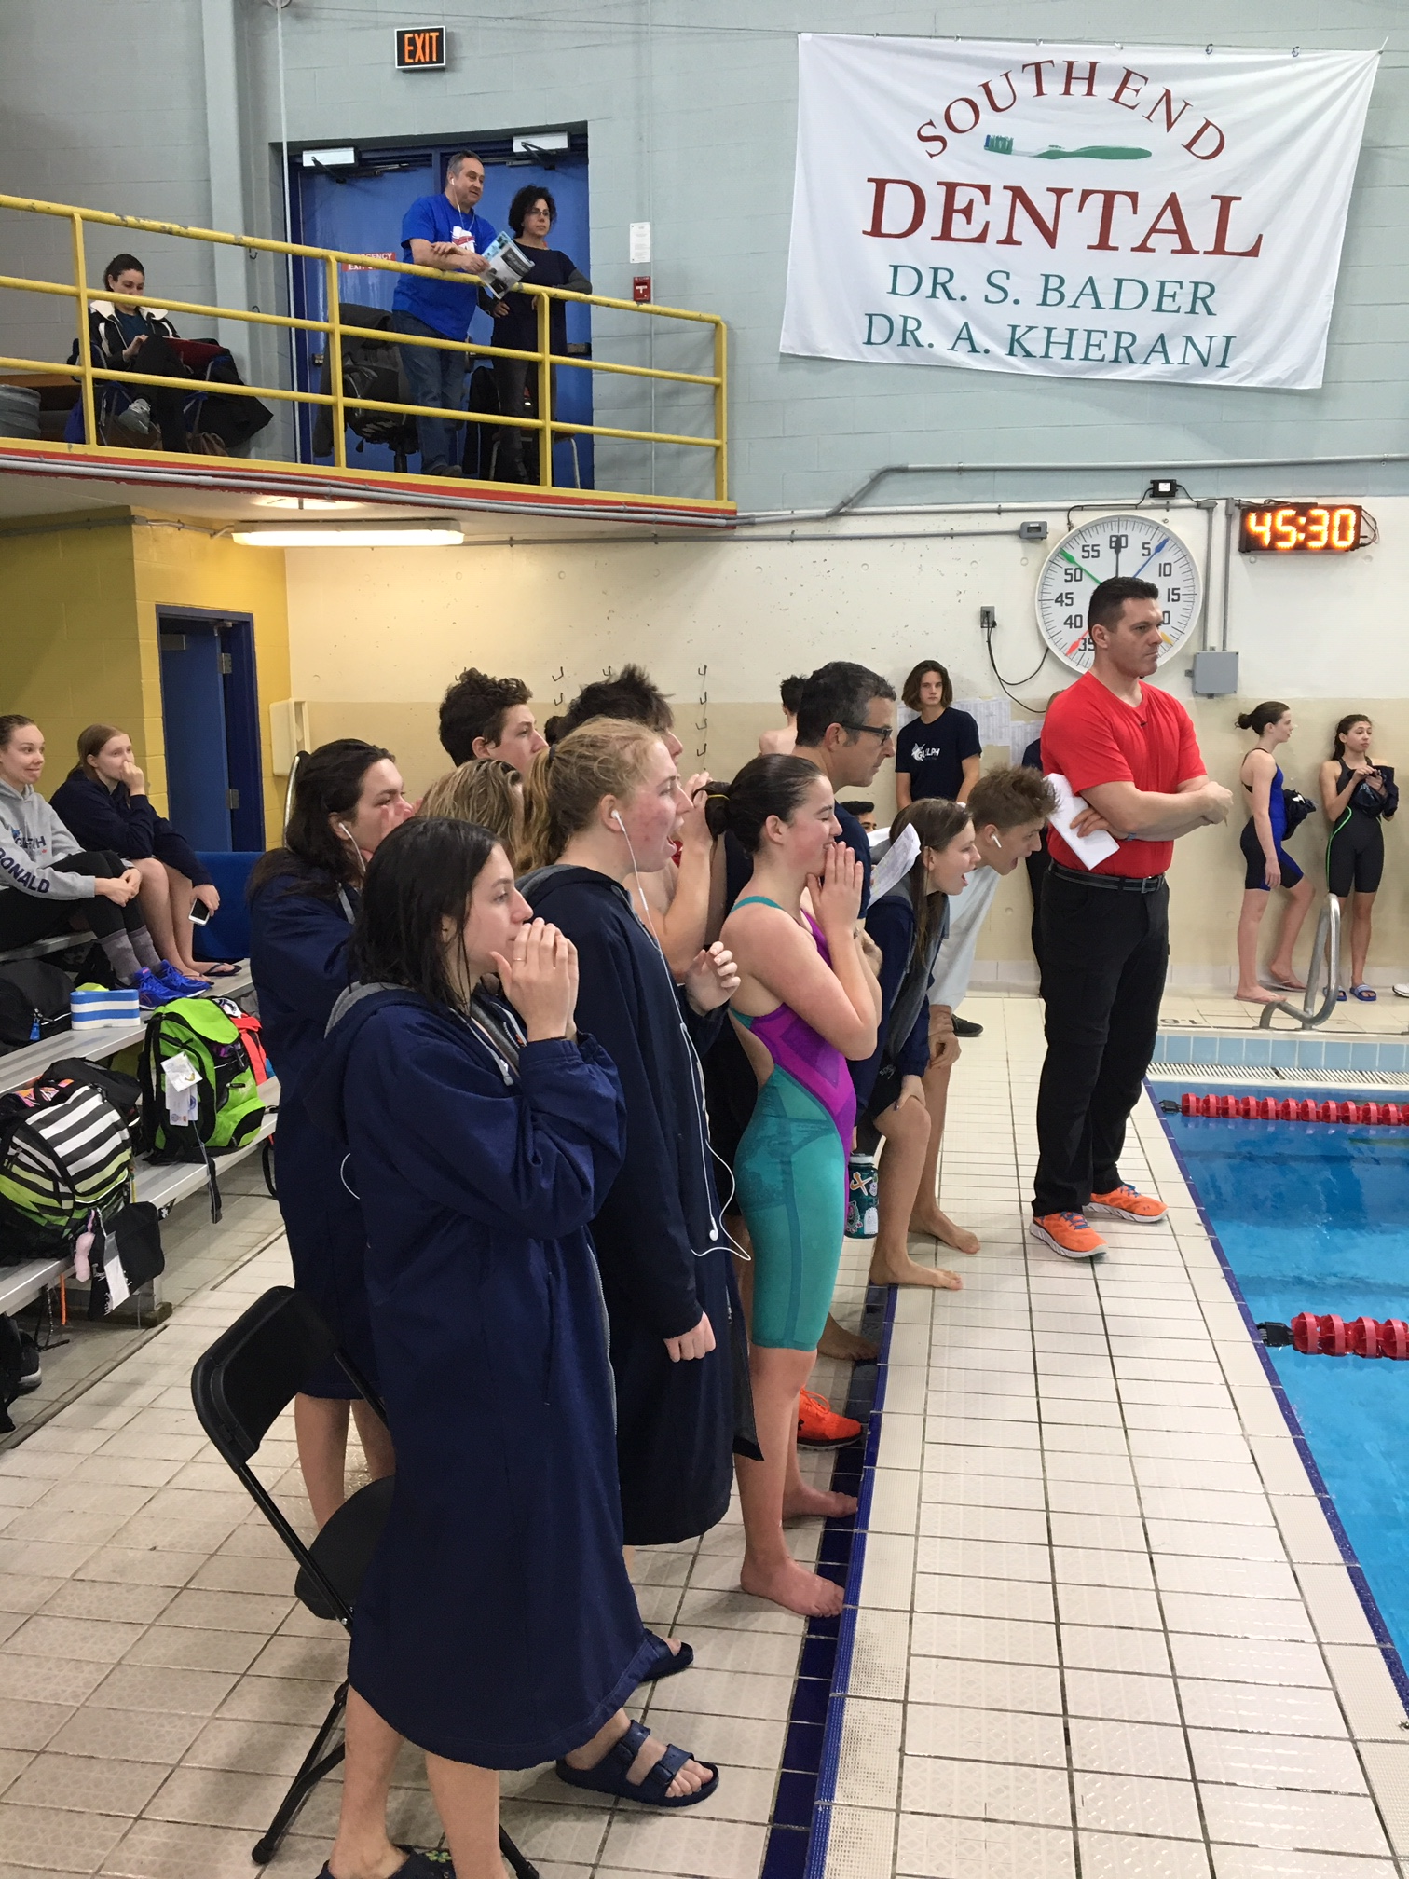
Carbohydrates (high intensity exercise requirement)
Glycogen is the major storage form of glucose and located in the muscle and liver.
Liver glycogen will be broken down to glucose-glucose will then enter the blood stream and either maintain blood glucose levels or be taken up by the muscle for additional energy (ATP production).
Muscle glycogen cannot leave the muscle- therefore will be oxidized to support any energy requirements of the skeletal muscle.
Increase exercise intensity (100-400m races).
Increased dependence on CHO as fuel.
Leads to quick depletion of glycogen stores in muscle.

Slide 6
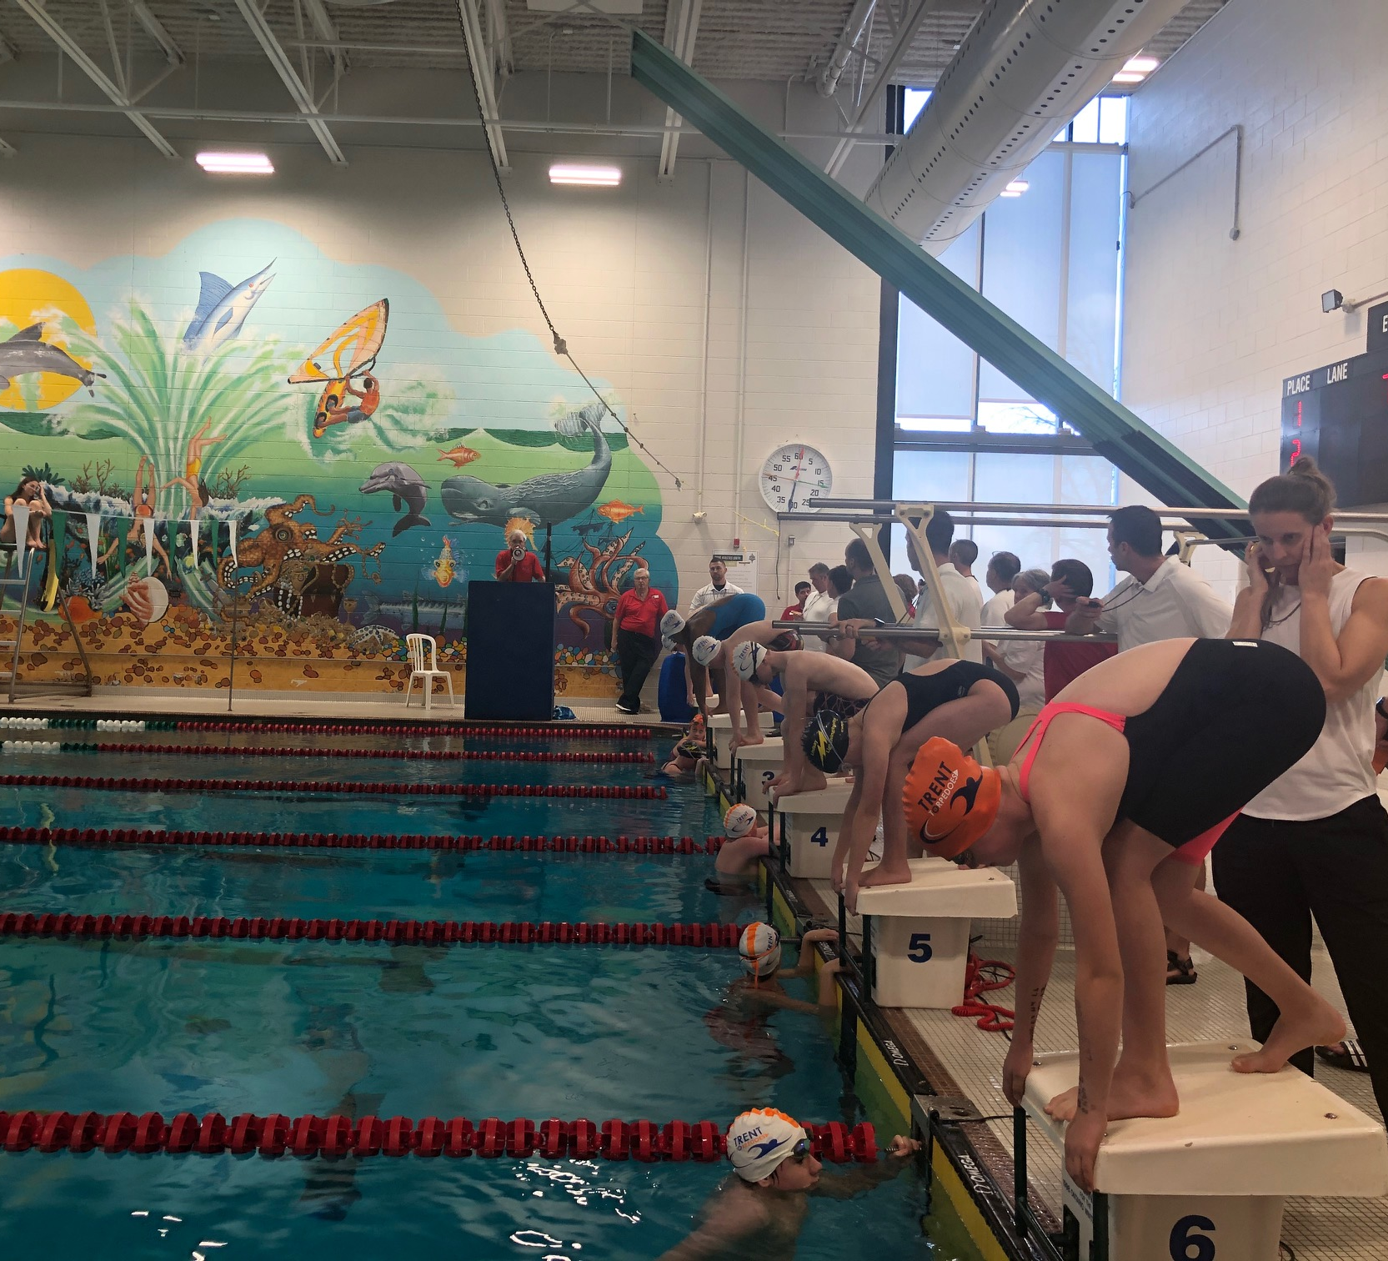
Adequate hydration
Fluids are important for swimmers, why:
To replace water lost during exercise.
To avoid decreases in performance due to hydration.
To help maintain core body temperature with acceptable limits.
To deliver carbohydrate during prolonged exercise (e.g. sport drink).
To provide electrolyte (sodium and potassium) lost through sweat (e.g. sport drink).

Slide 7
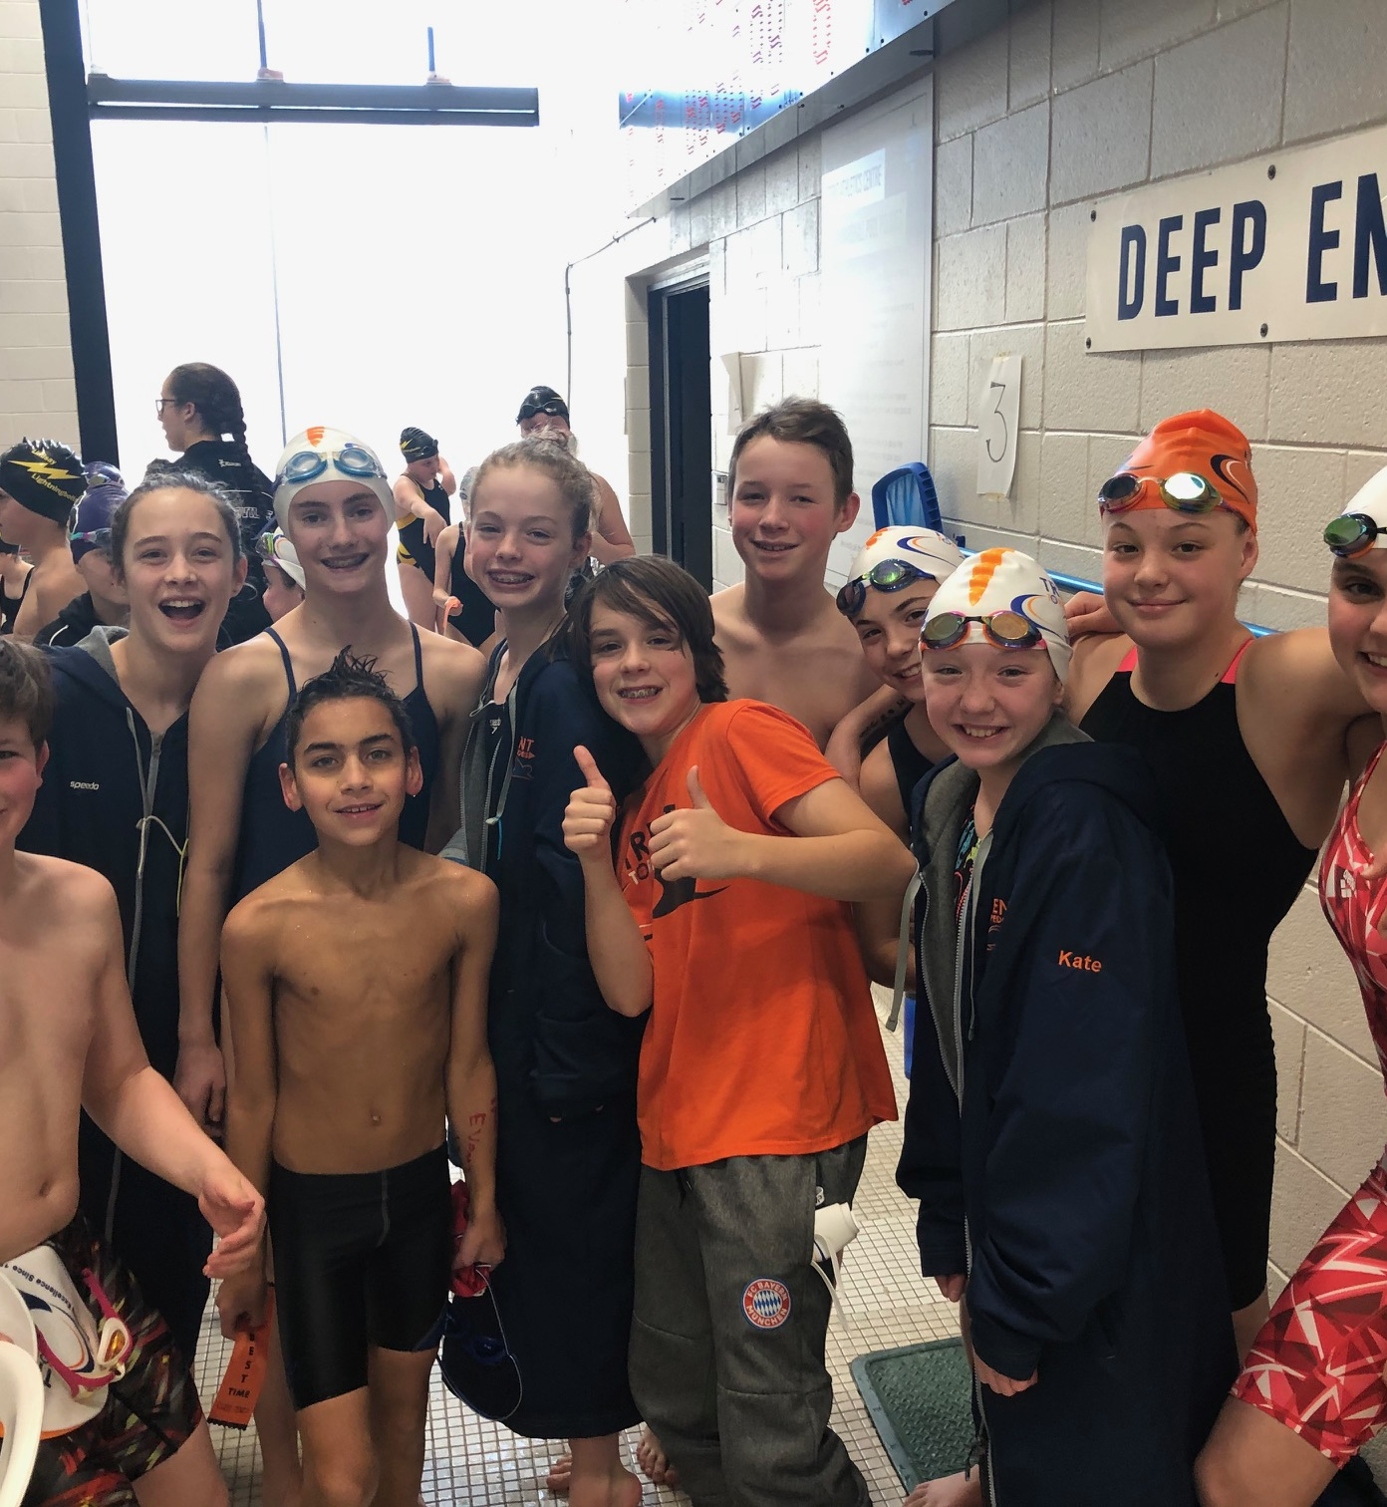
Fluids prior to exercise
Drink plenty of fluid daily to maintain weight and adequate urine output.
Drink 400-600 mL of fluid 2 to 3 hours before exercise.
Drink 150-350 mL of fluid minutes before exercise.
LIMIT beverages that contain caffeine and alcohol.

Slide 8
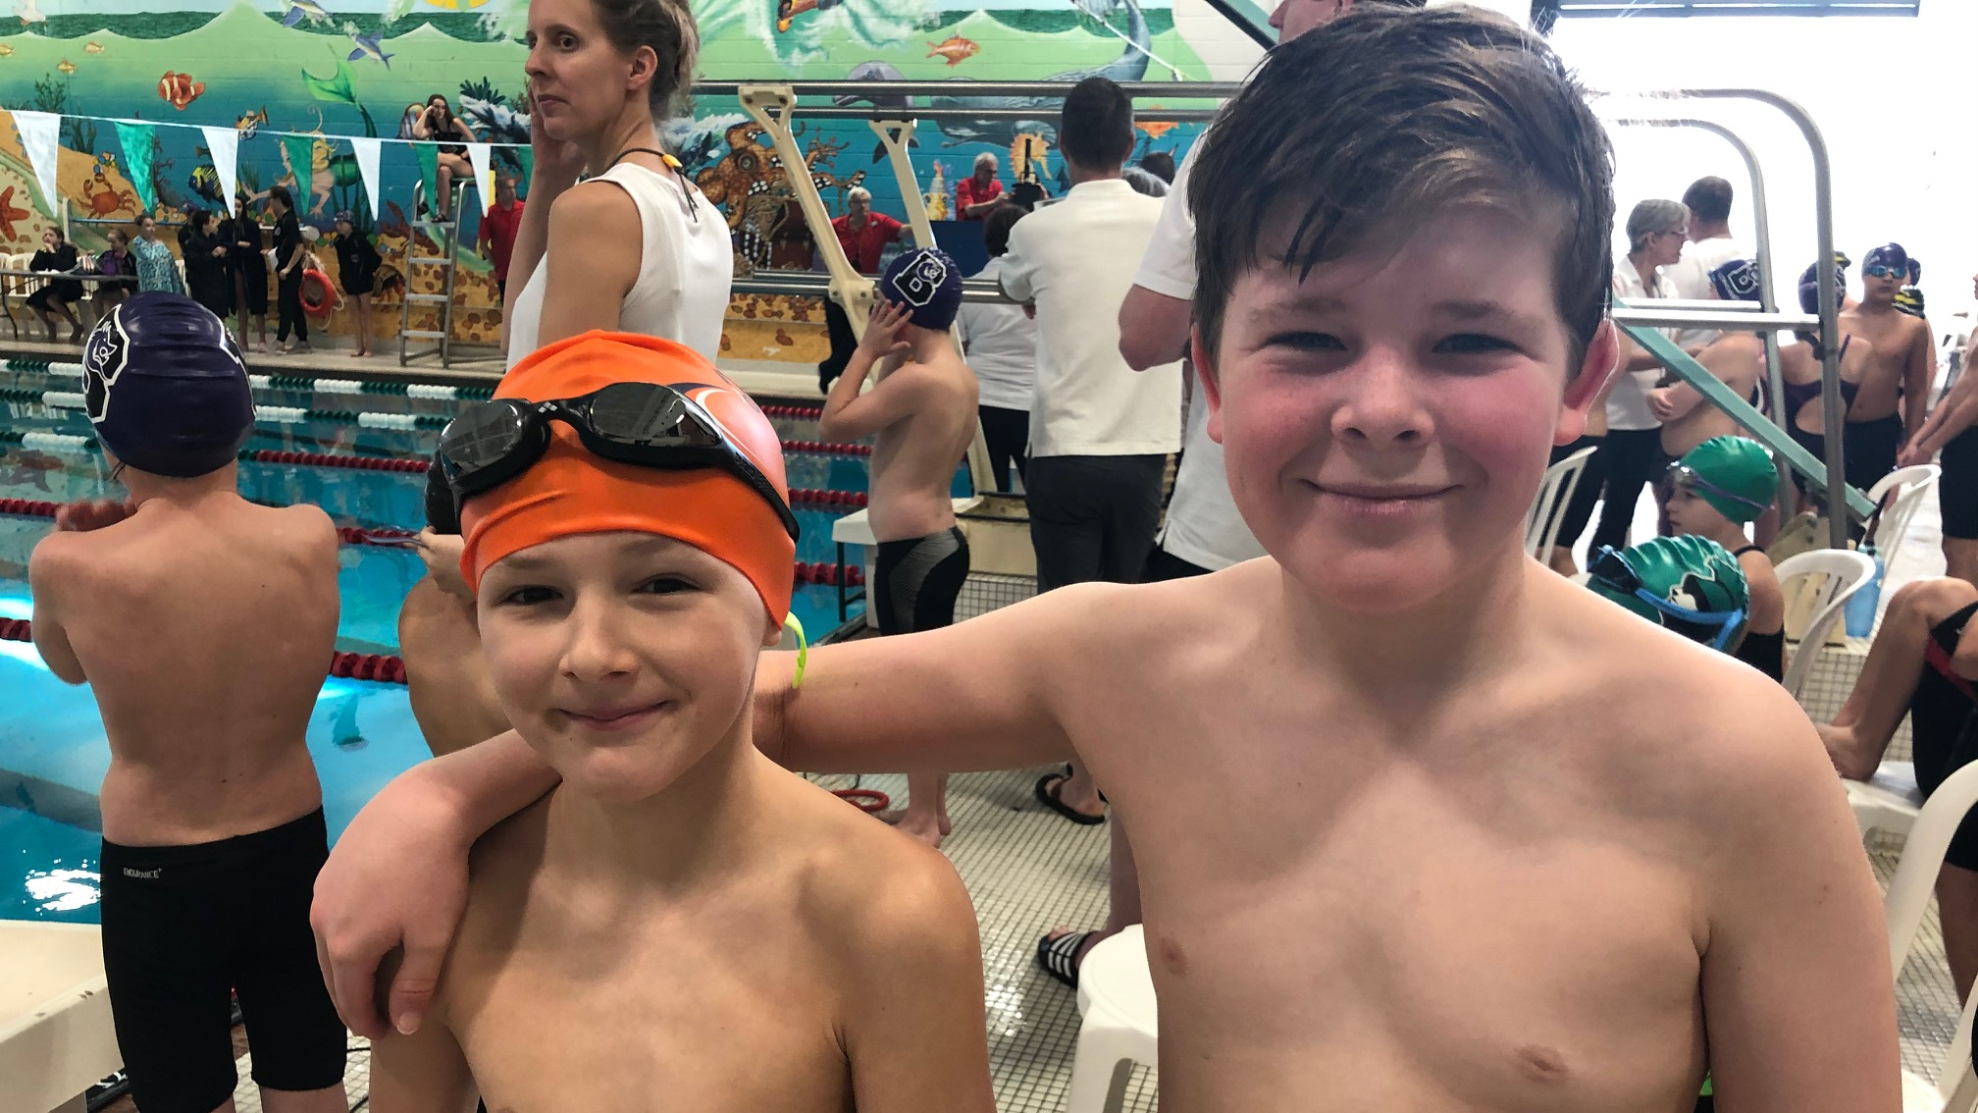
Fluids during exercise
Drink enough fluid to maintain fluid balance.
Drink 150-350 mL every 15-20 minutes.
Test how much you can tolerate without discomfort.
Athletes rarely consume enough to maximize the absorption rate for the digestive system.
Include sodium with or in fluids consumed during exercise.
Sodium helps maintain plasma electrolyte balance and the desire to drink (thirst mechanism).

Slide 9
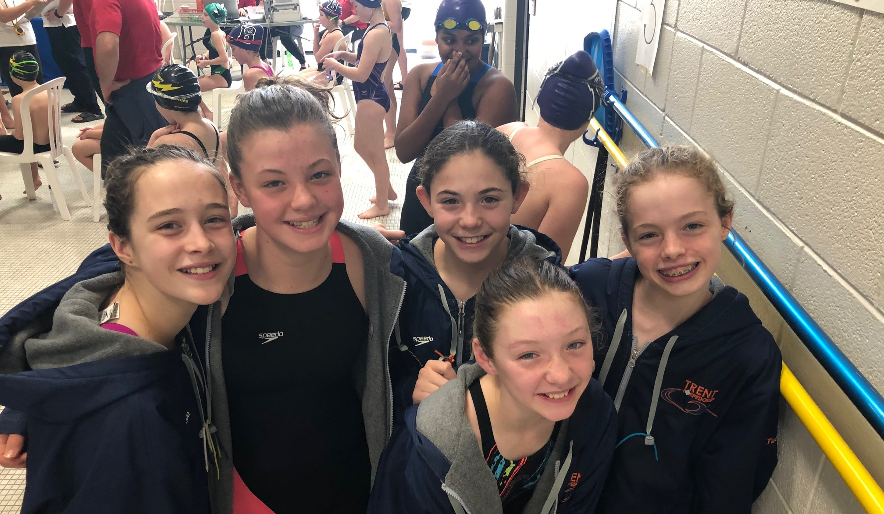
Carbohydrate – energy for endurance
If exercising more than 1 hour, consume carbohydrate with your fluids.
Commercial sport drinks containing 4% to 8% carbohydrate (40-80 g/L) are a suitable choice.
Test sport drinks in training, not in competition.
You can make a fluid replacement drink by mixing:
500 mL unsweetened orange juice
500 mL water
1.25-1.75 mL salt
One litre = 54 g (5.4%) carbohydrate and 0.5-0.7 g sodium.

Slide 10
Recovery after exercise
Drink
Drink 1.5 L of fluid every kilogram of weight lost during exercise.
Consume
Consume high carbohydrate foods and drinks.
Consume
Consume foods containing sodium (tomato or vegetable juice, commercial soup, low fat cheese, salted nuts) and foods containing potassium (vegetables, fruit, milk, legumes, or meat) to replace electrolytes.
Replace
Replace fluid loss by 150% (about 1.5 L per kg weight loss). For example, if 2 kg weight loss, drink 1.5 L x 2 (3L or 3,000 mL).
Drink
Drink beyond thirst – exercise dulls the thirst mechanism.

Slide 11
Nutrient timing post workout
Arguably, the most important timing- need to restore glycogen levels.
Ideally- we want CHO in our system within 30 minutes post workout.
The magnitude of the CHO is important as well - research has shown the more the carbohydrate consumed – the more glycogen restored.
Snack ideas: smoothies, egg sandwiches, chocolate milk, hummus, left over vegetables.

Slide 12
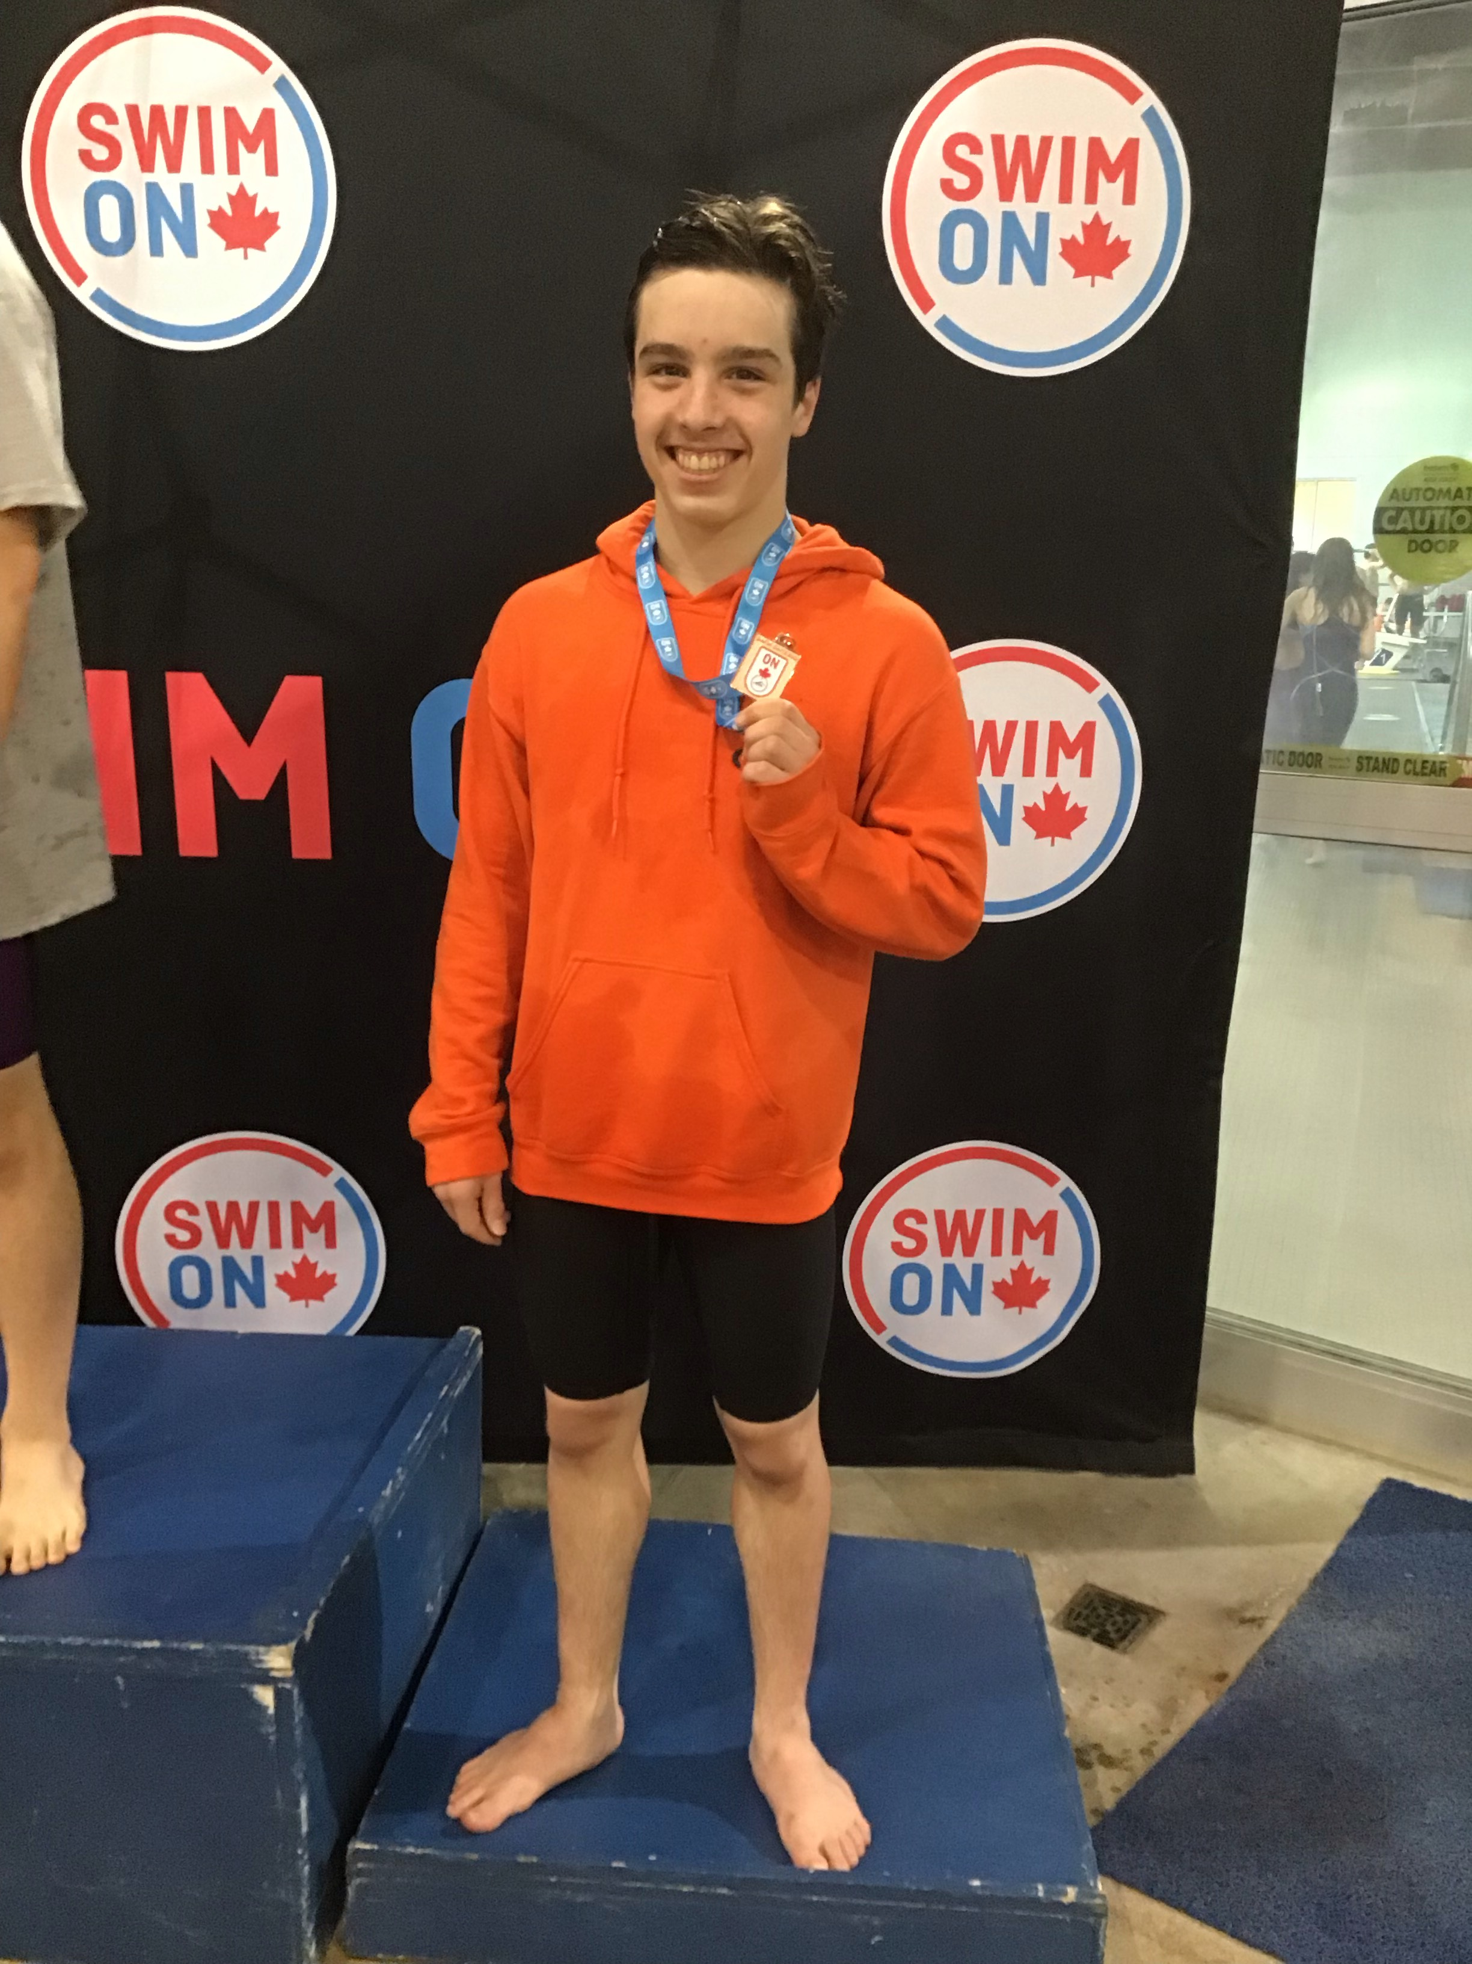
Supplements (the black boxes of nutrition)
This is an unregulated market.
Neither the food and drug administration (FDA) or the Canadian counterpart have stipulations regarding ingredients, manufacturing or truth in advertising practices.
Some ingredients not disclosed in the labelling.

Slide 13
Supplements (Biosteel et al)
Notes to consider:
Ingestion versus absorption.
Depends on the requirements of the activity.
Depends on caloric intakes.
Interactions with other nutritional balances.
Very little research in what gets excreted.
Can be masking other agents.
Expensive.

Slide 14
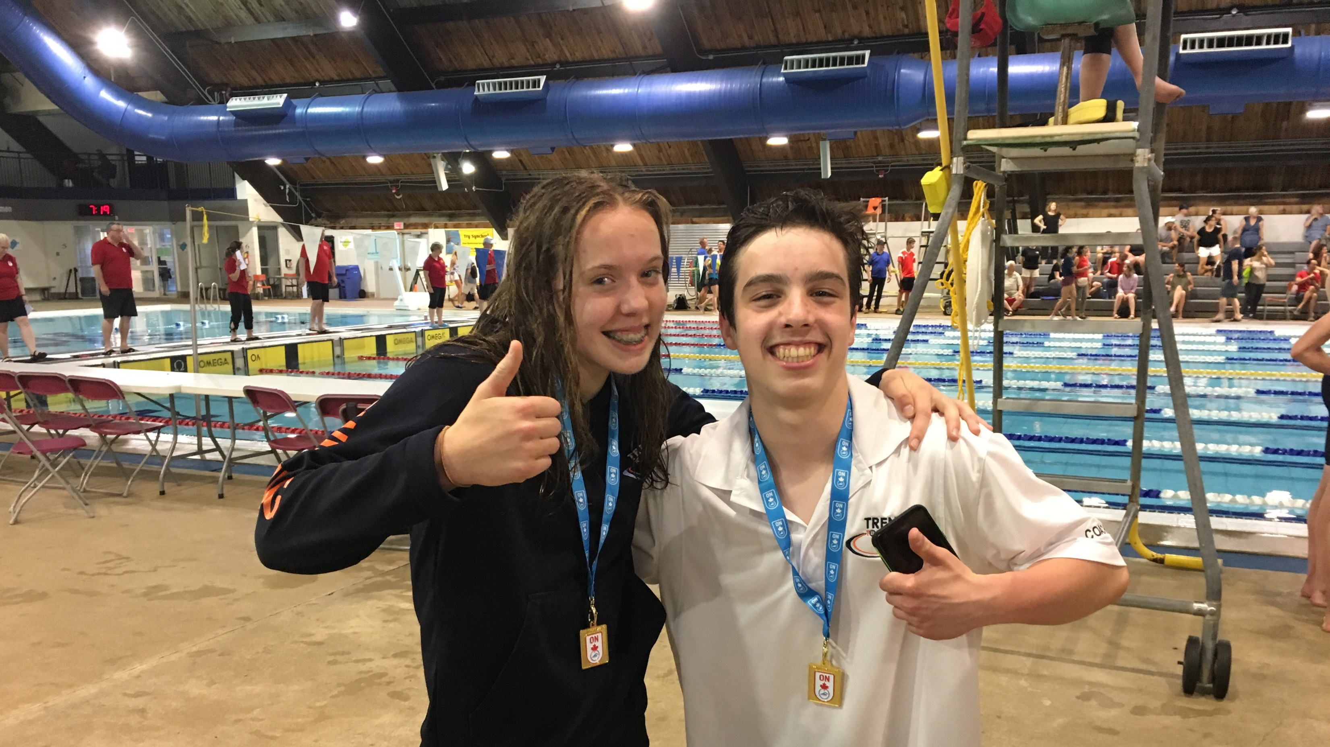
Other considerations
Ketosis (caloric manipulation).
Zone diet (based on research with Stanford women’s swim team)
Healthy and balance nutrition requires significant planning.
Many resources available.
Will yield in optimal performance.

Slide 15
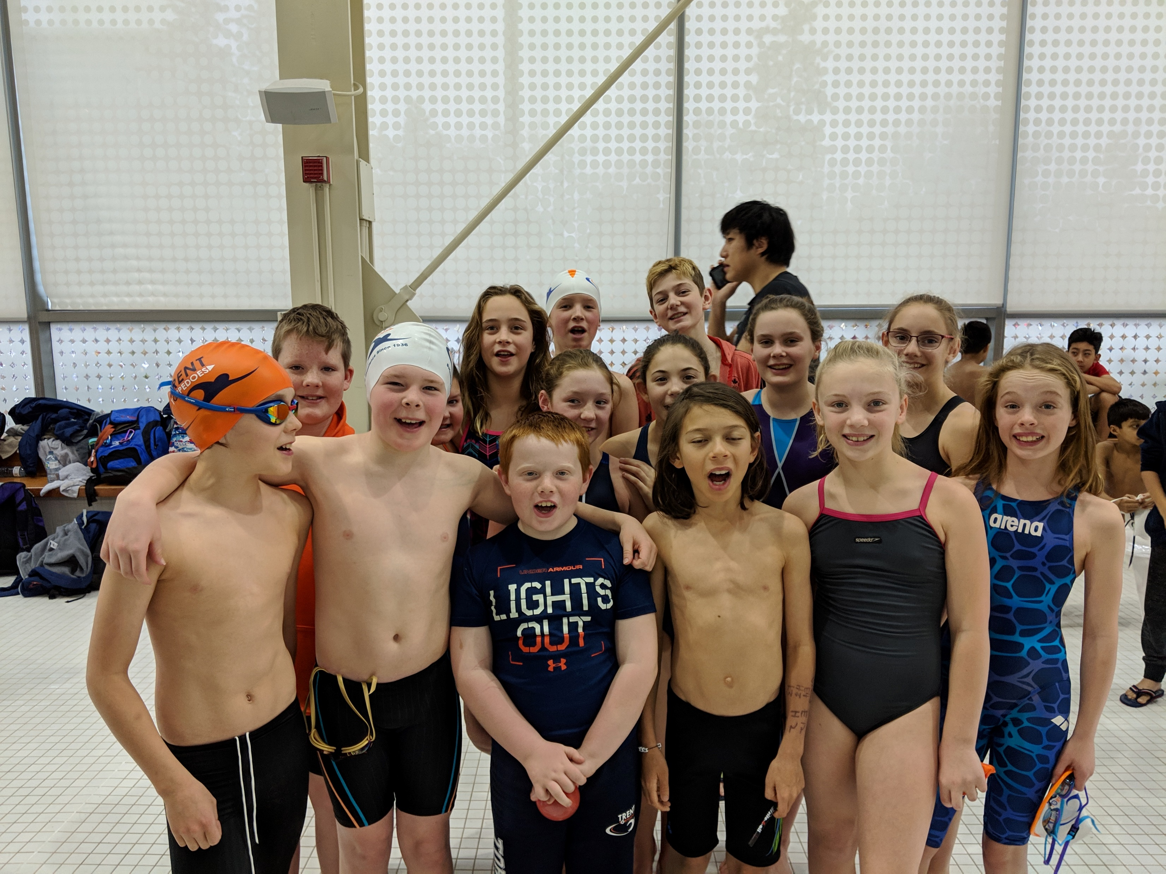
Balance is key.
Make wise choices.
Have appropriate expectations.
Do your homework and be skeptical of information sources.
Performance is achieved in the long term.
Build your hidden training.

Slide 16
Trent Swim Club
Ever to Excel

